Slide 1
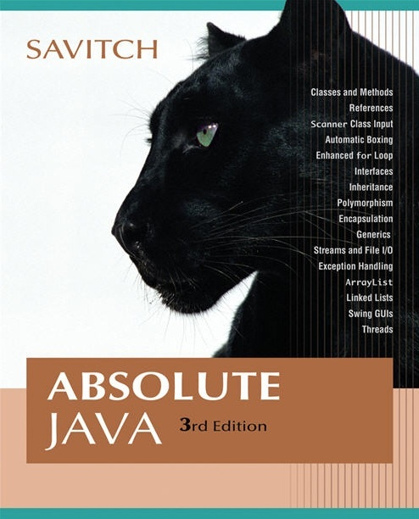


Chapter 11
Recursion
Copyright © 2008 Pearson Addison-Wesley. All rights reserved

Slide 2
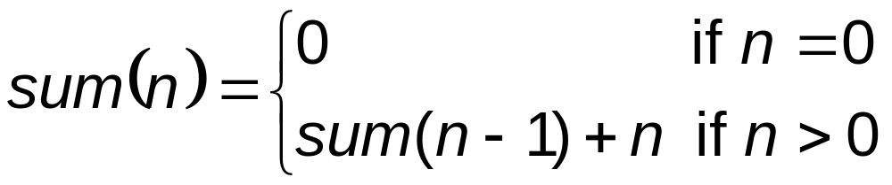
Recursion
You’ve seen recursive problem solving techniques used before in math
11-<number>

Slide 3
n! (n factorial)
n! for some non negative integer n is defined as:
  0! = 1 for n = 0
  1! = 1 for n = 1
  n! = n * (n-1)! for all other n > 1

Slide 4
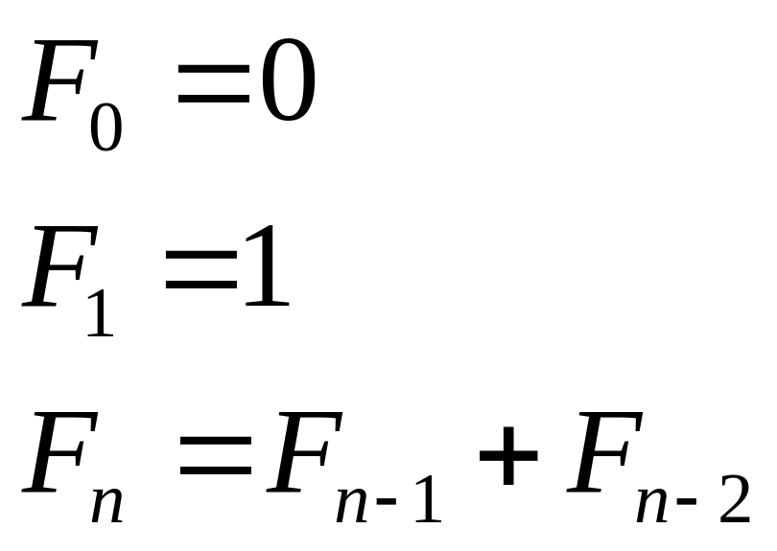
Fibonacci numbers
The sequence of Fibonacci numbers begins: 0, 1, 1, 2, 3, 5, 8, 13, 21, 34, 55, 89, 144, ...

Slide 5
Recursive void Methods
A recursive method is a method that includes a call to itself
Recursion is based on the general problem solving technique of breaking down a task into subtasks
  In particular, recursion can be used whenever one subtask is a smaller version of the original task
Copyright © 2008 Pearson Addison-Wesley. All rights reserved
11-<number>

Slide 6
Vertical Numbers
The static recursive method writeVertical takes one (nonnegative) int argument, and writes that int with the digits going down the screen one per line
  Note: Recursive methods need not be static
This task may be broken down into the following two subtasks
  Simple case: If n<10, then write the number n to the screen
  Recursive Case: If n>=10, then do two subtasks:
    Output all the digits except the last digit
    Output the last digit
Copyright © 2008 Pearson Addison-Wesley. All rights reserved
11-<number>

Slide 7
Vertical Numbers
Given the argument 1234, the output of the first subtask would be:
  1
  2
  3
The output of the second part would be:
  4
Copyright © 2008 Pearson Addison-Wesley. All rights reserved
11-<number>

Slide 8
Vertical Numbers
The decomposition of tasks into subtasks can be used to derive the method definition:
  Subtask 1 is a smaller version of the original task, so it can be implemented with a recursive call
  Subtask 2 is just the simple case
Copyright © 2008 Pearson Addison-Wesley. All rights reserved
11-<number>

Slide 9
Algorithm for Vertical Numbers
Given parameter n in writeVertical
if (n<10)
System.out.println(n);
else
{
writeVertical
(the number n with the last digit removed);
System.out.println(the last digit of n);
}
Copyright © 2008 Pearson Addison-Wesley. All rights reserved
11-<number>

Slide 10
Program for Vertical Numbers
public static void writeVertical(int n)
{
if (n < 10) // base/termination case
{
System.out.println(n);
}
else // n is two or more digits long: recursive step
{
writeVertical( n/10 );
System.out.println( n%10 );
}
}
11-<number>

Slide 11
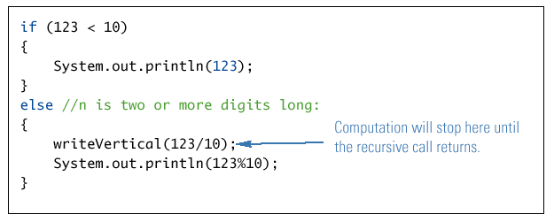
Execution of writeVertical(123)
Copyright © 2008 Pearson Addison-Wesley. All rights reserved
11-<number>

Slide 12
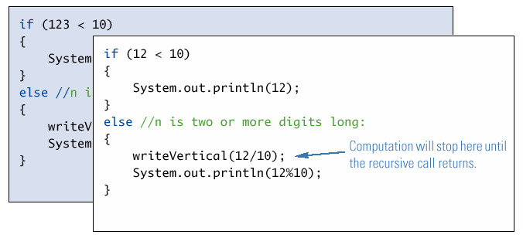
Execution of writeVertical(12)
Copyright © 2008 Pearson Addison-Wesley. All rights reserved
11-<number>

Slide 13
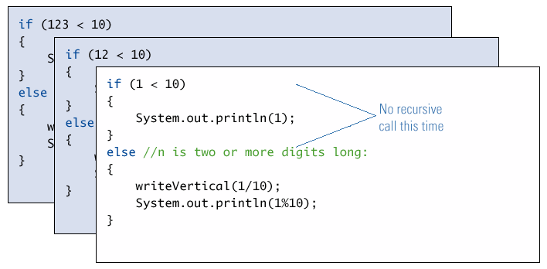
Execution of writeVertical(1)
Copyright © 2008 Pearson Addison-Wesley. All rights reserved
11-<number>

Slide 14
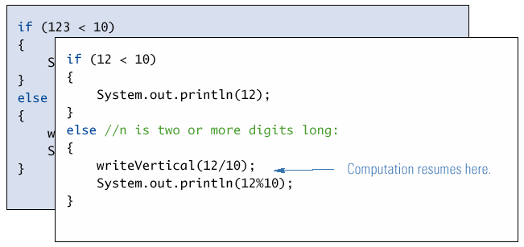
Completion of writeVertical(12)
Copyright © 2008 Pearson Addison-Wesley. All rights reserved
11-<number>

Slide 15
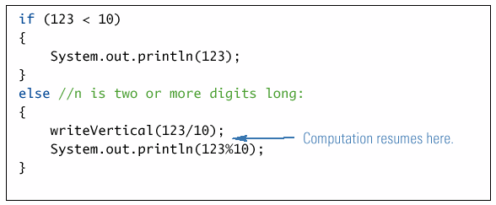
Completion of writeVertical(123)
Copyright © 2008 Pearson Addison-Wesley. All rights reserved
11-<number>

Slide 16
A Closer Look at Recursion
The computer keeps track of recursive calls as follows:
  When a method is called, the computer plugs in the arguments for the parameter(s), and starts executing the code
  If it encounters a recursive call, it temporarily stops (suspends) its computation
  When the recursive call is completed, the computer returns to finish the suspended computation
Copyright © 2008 Pearson Addison-Wesley. All rights reserved
11-<number>

Slide 17
A Closer Look at Recursion
When the computer encounters a recursive call, it must temporarily suspend its execution of a method
  It does this because it must know the result of the recursive call before it can proceed
  It saves all the information it needs to continue the computation later on, when it returns from the recursive call
Ultimately, this entire process terminates when one of the recursive calls does not depend upon recursion to return
Copyright © 2008 Pearson Addison-Wesley. All rights reserved
11-<number>

Slide 18
Pitfall: Infinite Recursion
In the writeVertical example, the series of recursive calls eventually reached a call of the method that did not involve recursion (a stopping case)
If, instead, every recursive call had produced another recursive call, then a call to that method would, in theory, run forever
  This is called infinite recursion
  In practice, such a method runs until the computer runs out of resources, and the program terminates abnormally
Copyright © 2008 Pearson Addison-Wesley. All rights reserved
11-<number>

Slide 19
Pitfall: Infinite Recursion
An alternative version of writeVertical
  Note: No stopping case!
  public static void
  newWriteVertical(int n)
  {
  newWriteVertical(n/10);
  System.out.println(n%10);
  }
Copyright © 2008 Pearson Addison-Wesley. All rights reserved
11-<number>

Slide 20
Stacks for Recursion
To keep track of recursion (and other things), most computer systems use a stack
  A stack is a very specialized kind of memory structure analogous to a stack of paper
  As an analogy, there is also an inexhaustible supply of extra blank sheets of paper
  Information is placed on the stack by writing on one of these sheets, and placing it on top of the stack (becoming the new top of the stack)
  More information is placed on the stack by writing on another one of these sheets, placing it on top of the stack, and so on
Copyright © 2008 Pearson Addison-Wesley. All rights reserved
11-<number>

Slide 21
Stacks for Recursion
  To get information out of the stack, the top paper can be read, but only the top paper
  To get more information, the top paper can be thrown away, and then the new top paper can be read, and so on
Since the last sheet put on the stack is the first sheet taken off the stack, a stack is called a last-in/first-out memory structure (LIFO)
Copyright © 2008 Pearson Addison-Wesley. All rights reserved
11-<number>

Slide 22
Stacks for Recursion
To keep track of recursion, whenever a method is called, a new "sheet of paper" is taken
  The method definition is copied onto this sheet, and the arguments are plugged in for the method parameters
  The computer starts to execute the method body
  When it encounters a recursive call, it stops the computation in order to make the recursive call
  It writes information about the current method on the sheet of paper, and places it on the stack
Copyright © 2008 Pearson Addison-Wesley. All rights reserved
11-<number>

Slide 23
Stacks for Recursion
Depending on how many recursive calls are made, and how the method definition is written, the stack may grow and shrink in any fashion
The stack of paper analogy has its counterpart in the computer
  The contents of one of the sheets of paper is called a stack frame or activation record
  The stack frames don't actually contain a complete copy of the method definition, but reference a single copy instead
Copyright © 2008 Pearson Addison-Wesley. All rights reserved
11-<number>

Slide 24
Pitfall: Stack Overflow
There is always some limit to the size of the stack
  If there is a long chain in which a method makes a call to itself, and that call makes another recursive call, . . . , and so forth, there will be many suspended computations placed on the stack
  If there are too many, then the stack will attempt to grow beyond its limit, resulting in an error condition known as a stack overflow
A common cause of stack overflow is infinite recursion
Copyright © 2008 Pearson Addison-Wesley. All rights reserved
11-<number>

Slide 25
Recursion Versus Iteration
Recursion is not absolutely necessary
  Any task that can be done using recursion can also be done in a nonrecursive manner
  A nonrecursive version of a method is called an iterative version
An iteratively written method will typically use loops of some sort in place of recursion
A recursively written method can be simpler, but will usually run slower and use more storage than an equivalent iterative version
Copyright © 2008 Pearson Addison-Wesley. All rights reserved
11-<number>

Slide 26
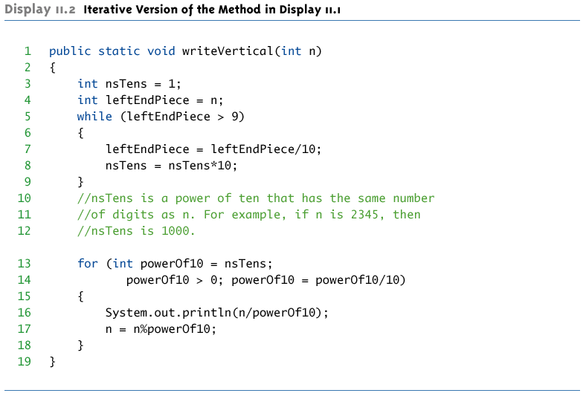
Iterative version of writeVertical
Copyright © 2008 Pearson Addison-Wesley. All rights reserved
11-<number>

Slide 27
Recursive Methods that Return a Value
Recursion is not limited to void methods
A recursive method can return a value of any type
An outline for a successful recursive method that returns a value is as follows:
  One or more cases in which the value returned is computed in terms of calls to the same method
  the arguments for the recursive calls should be intuitively "smaller“
  One or more cases in which the value returned is computed without the use of any recursive calls (the base or stopping cases)
Copyright © 2008 Pearson Addison-Wesley. All rights reserved
11-<number>

Slide 28
The Recursive Method power
public static int power(int x, int n)
{
if (n < 0)
{
System.out.println("Illegal argument to power.");
System.exit(0);
}
if (n == 0) //base
return (1);
else // n > 0
return ( power(x, n - 1) * x );
}
11-<number>

Slide 29
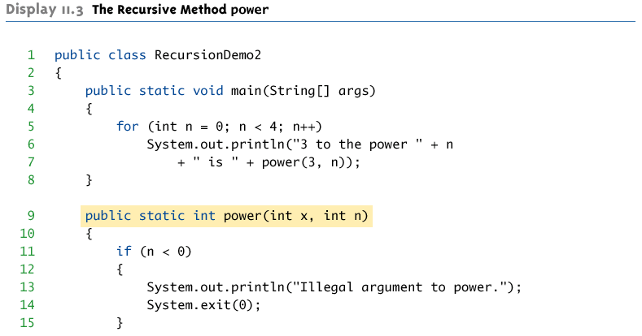
The Recursive Method power
(Part 1 of 2)
Copyright © 2008 Pearson Addison-Wesley. All rights reserved
11-<number>

Slide 30
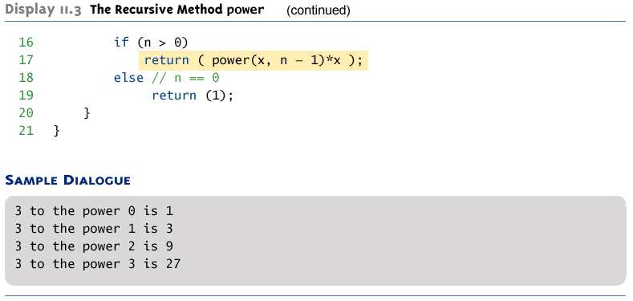
The Recursive Method power
(Part 1 of 2)
Copyright © 2008 Pearson Addison-Wesley. All rights reserved
11-<number>

Slide 31
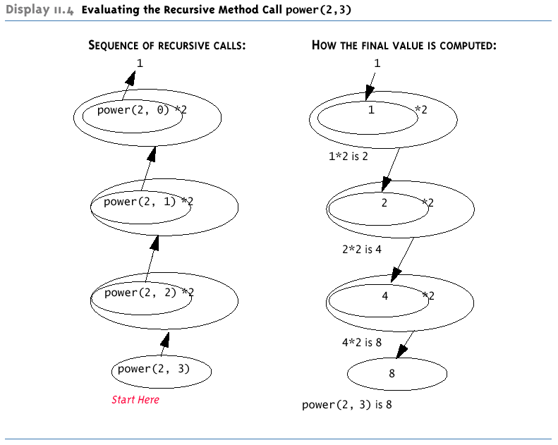
Evaluating the Recursive Method Call power(2,3)
Copyright © 2008 Pearson Addison-Wesley. All rights reserved
11-<number>

Slide 32
Linear Search
Linear search searches an array to find a specified value (a key)
The array need not be a sorted array:
If the value is found, its index is returned
If the value is not found, -1 is returned
Linear Search is very slow if there is a large number of elements in the array.
11-<number>

Slide 33
Binary Search
Binary search uses a recursive method to search an array to find a specified value
The array must be a sorted array:
  a[0]≤a[1]≤a[2]≤. . . ≤ a[finalIndex]
If the value is found, its index is returned
If the value is not found, -1 is returned
Copyright © 2008 Pearson Addison-Wesley. All rights reserved
11-<number>

Slide 34
Binary Search
An algorithm to solve this task looks at the middle of the array or array segment first
If the value looked for is smaller than the value in the middle of the array
  Then the second half of the array or array segment can be ignored
  This strategy is then applied to the first half of the array or array segment
  Note: Each execution of the recursive method reduces the search space by about a half
Copyright © 2008 Pearson Addison-Wesley. All rights reserved
11-<number>

Slide 35
Binary Search
If the value looked for is larger than the value in the middle of the array or array segment
  Then the first half of the array or array segment can be ignored
  This strategy is then applied to the second half of the array or array segment
If the value looked for is at the middle of the array or array segment, then it has been found
If the entire array (or array segment) has been searched in this way without finding the value, then it is not in the array
Copyright © 2008 Pearson Addison-Wesley. All rights reserved
11-<number>

Slide 36
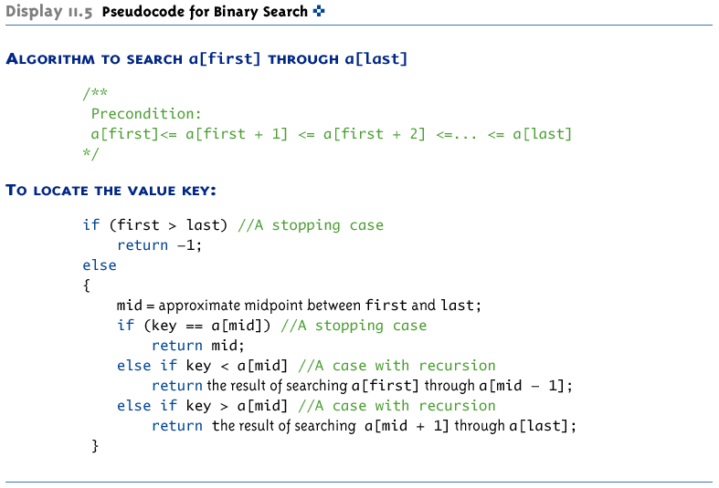
Pseudocode for Binary Search
Copyright © 2008 Pearson Addison-Wesley. All rights reserved
11-<number>

Slide 37
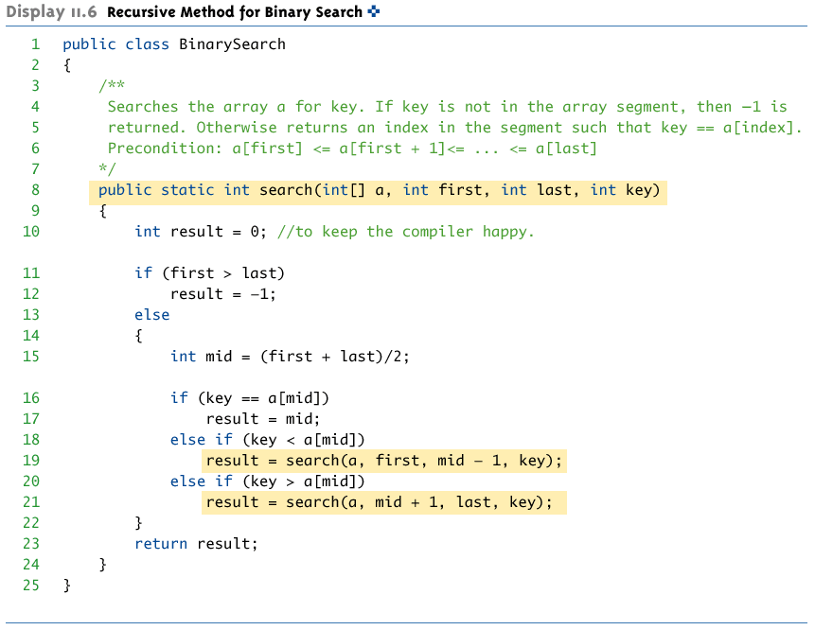
Recursive Method for Binary Search
Copyright © 2008 Pearson Addison-Wesley. All rights reserved
11-<number>

Slide 38
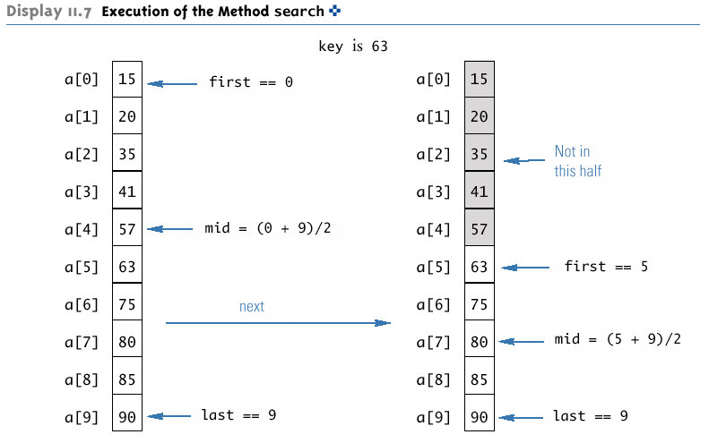
Execution of the Method search
(Part 1 of 2)
Copyright © 2008 Pearson Addison-Wesley. All rights reserved
11-<number>

Slide 39
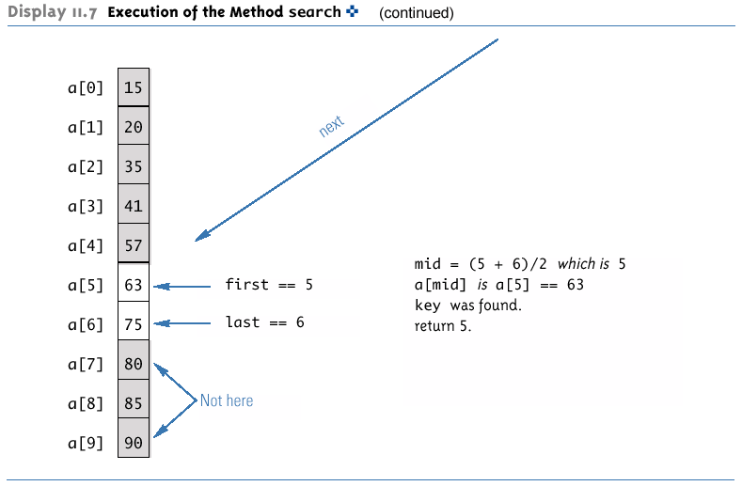
Execution of the Method search
(Part 1 of 2)
Copyright © 2008 Pearson Addison-Wesley. All rights reserved
11-<number>

Slide 40
Execution of the Method search (What if key = 64 ?)
11-<number>

Slide 41
Efficiency of Binary Search
Given an array with 1,000 elements, the binary search will only need to compare about 10 array elements to the key value, as compared to an average of 500 for a serial (linear) search algorithm
The binary search algorithm has a worst-case running time that is logarithmic: O(log n)
  A serial search algorithm is linear: O(n)
If desired, the recursive version of the method search can be converted to an iterative version that will run more efficiently
Copyright © 2008 Pearson Addison-Wesley. All rights reserved
11-<number>

Slide 42
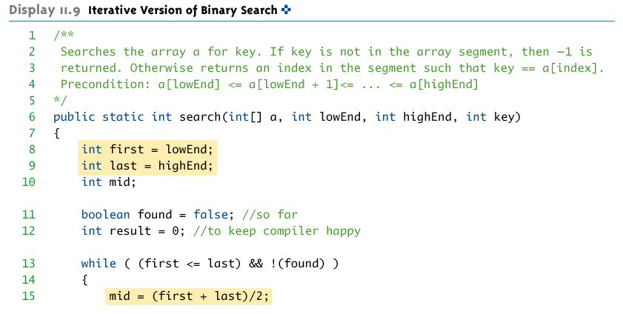
Iterative Version of Binary Search
(Part 1 of 2)
Copyright © 2008 Pearson Addison-Wesley. All rights reserved
11-<number>

Slide 43
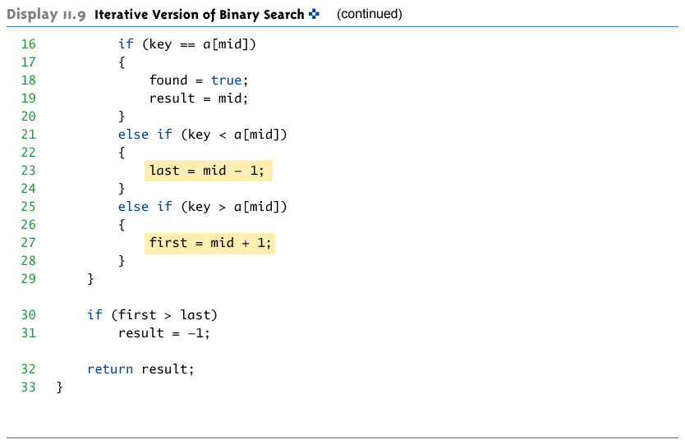
Iterative Version of Binary Search
(Part 2 of 2)
Copyright © 2008 Pearson Addison-Wesley. All rights reserved
11-<number>

Slide 44

More Examples
Copyright © 2008 Pearson Addison-Wesley. All rights reserved
11-<number>

Slide 45
n! (n factorial)
n! for some non negative integer n can be rewritten as:
  0! = 1 for n = 0
  1! = 1 for n = 1
  n! = n * (n-1)! for all other n > 1

Slide 46
Let’s code n! (n factorial)
n! for some non negative integer n can be rewritten as:
  0! = 1 for n = 0
  1! = 1 for n = 1
  n! = n * (n-1)! for all other n > 1
public static int Factorial ( int n ) {
//base cases
if (n==0) return 1;
if (n==1) return 1;
return n * Factorial( n-1 );
}
This is an example of a recursive function (a function that calls itself)!
To use this function:
int result = Factorial( 10 );

Slide 47
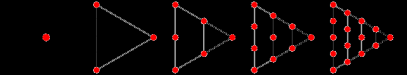
Triangular numbers
The triangular number T_{n} can be represented in the form of a triangular grid of points where the first row contains a single element and each subsequent row contains one more element than the previous one. The triangular numbers are therefore 1, 1+2, 1+2+3, 1+2+3+4, ..., so the first few triangle numbers are 1, 3, 6, 10, 15, 21, ...

Slide 48
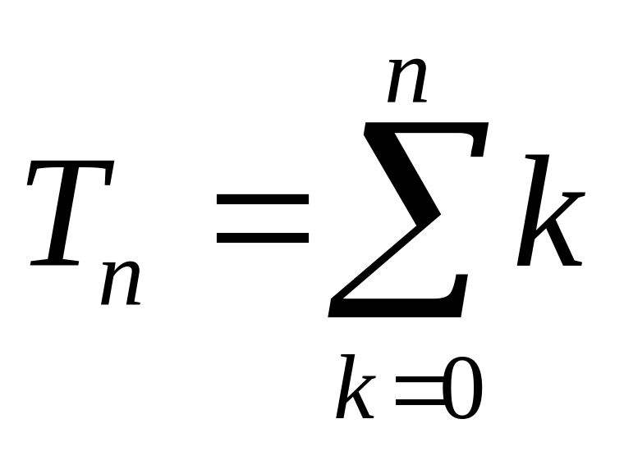
Triangular numbers
which can also be expressed as:
  T_{n} = 1 for n = 1
  T_{n} = n + T_{n-1} for n > 1

Slide 49
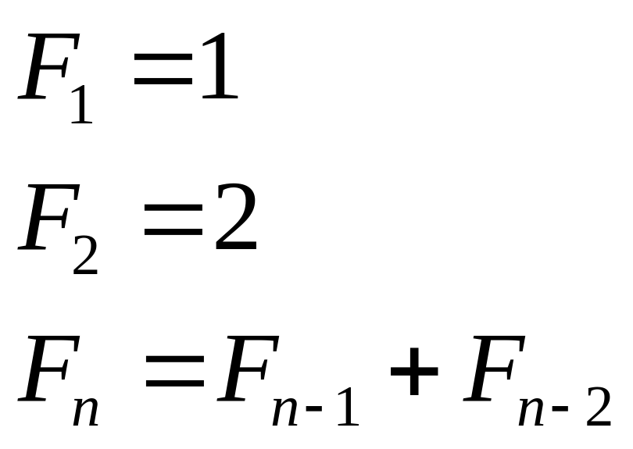
Fibonacci numbers
The sequence of Fibonacci numbers begins: 1, 1, 2, 3, 5, 8, 13, 21, 34, 55, 89 ...

Slide 50
A note regarding recursion . . .
Calculations such as factorial, Fibonacci numbers, etc. are fine for introducing the idea of recursion.
But the real power of recursion is in traversing advanced data structures such as trees (covered in more advanced classes and used in such applications as language parsing, games, etc.).

Slide 51
/**
* Chapter 11 programming Project 1
*
* This program recursively computes compound interest..
*
*/
import java.util.Scanner;
public class Question1Interest
{
/**
* calculateSavings
* Recursively compute compound interest.
* The recursive definition is:
* savings(d,i,y) = savings((d*i)+d,i,y-1)
* where d = initial deposit, i = interest rate, y = number of years
* @param initial_deposit Initial amount of deposit
* @param yearly_interest_rate Interest rate, value between 0-1
* @param num_years integer that is number of years
* @return double Savings accrued at the interest rate after the number of years
*/

Slide 52
public static double calculateSavings(double initial_deposit, double yearly_interest_rate,
int num_years)
{
// Base case -- if num_years = 0, then we just get the amount of
// the initial deposit
  if (num_years == 0)
  return initial_deposit;
// If num_years > 0, then for the first year we make
// (interest_rate * initial_deposit) + initial_deposit. Feed this into the
// same function, but now for one fewer year since we have accounted
// for the value after this year.
else
return calculateSavings(
(initial_deposit * yearly_interest_rate) + initial_deposit, yearly_interest_rate, num_years - 1);
}

Slide 53
public static double calculateSavings(double initial_deposit, double yearly_interest_rate,
int num_years)
{
if (num_years == 0)
return initial_deposit;
else
return calculateSavings(
( initial_deposit * yearly_interest_rate) + initial_deposit, yearly_interest_rate, num_years - 1);
}

Slide 54
// ======================
// main method
// ======================
public static void main(String[] args)
{
// Input variables
double initial_amount;
double interest_rate;
int num_years;
double future_value;
Scanner scan = new Scanner(System.in);
System.out.println("Enter initial amount to save:");
initial_amount = scan.nextDouble();
System.out.println("Enter yearly interest rate (e.g. 0.10 for 10%)");
interest_rate = scan.nextDouble();
System.out.println("Enter number of years of compounded interest. ");
num_years = scan.nextInt();
future_value = calculateSavings(initial_amount, interest_rate, num_years);
System.out.println("$" + initial_amount + " after " + num_years + " years, at " +
interest_rate + " would amount to $" + future_value);
}
} // Question1Interest

